Slide 1
Effectively Communicate about Your Direct Reports
Summary: Advocating for your team’s interests will almost always require you to communicate with stakeholders much higher than you in the organization. These folks are time-constrained, so being focused is key.
Some good managers fall into a trap of trying to encapsulate everything about their direct reports to show why they’re so valuable. This is a mistake! Your points will get muddled and you will test senior stakeholders’ patience.
Instead, stay concise and persuasive by focusing on three aspects of your report’s performance:
Impact that they’ve had on the business, with as much quantifiable data as possible.
Top strengths, especially those that differentiate them from peers.
Opportunities for growth; others will bring these up, so take control of the narrative by explaining where your report can improve and (hopefully) how they’re already working to address their challenges.
When to use this template: Prepare a summary of your report’s performance ahead of end-of-year performance reviews, for promotion panels or discussions about raises, or as needed to deliver effective upward messaging about your report.
Tips: In addition to the other best practices described on this page, adding your report’s picture can help put a face with a name, making them more memorable for busy leaders who may not have much personal interaction with your team members.
For promotions, clarify how much time the person has spent in role, and evaluate whether this number is more or less than the average at your organization. If your seeking a faster promotion, be prepared to explain why your report is ready with less time-in-seat than others in their position.

Slide 2
Firstname Lastname
Current Position: Title
Candidate for Promotion to: Title
Picture
Previous Performance Reviews: [Year]–Rating/Score | [Year]–Rating/Score
Tenure: [how long they’ve been in their current role]
Impact and Achievements
Impact with quantitative data 1
Impact with quantitative data 2
Impact with quantitative data 3
Strengths
Strength 1:
Strength 2:
Strength 3:
Opportunities
Opportunity 1:
Opportunity 2:
Notes:
https://www.istockphoto.com/photo/young-happy-mixed-race-businessman-standing-with-his-arms-crossed-working-alone-in-gm1399565382-453399847?phrase=headshot+hispanic+smile+male&searchscope=image%2Cfilm

Slide 3
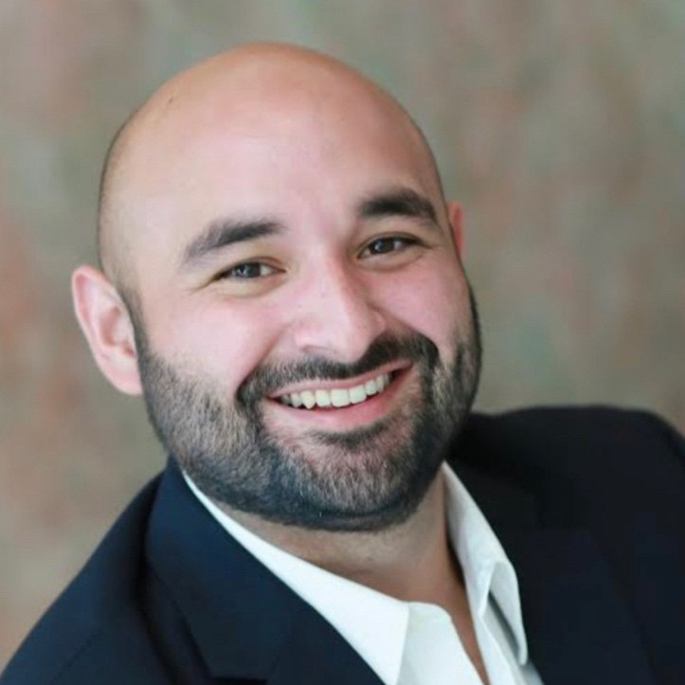
Ricardo Hernandez
Current Position: Senior Analyst
Candidate for Promotion to: Consultant
Example
Previous Performance Reviews: 2021–Meets Expectations | 2022–Exceeds Expectations
Tenure: 19 months in role
Impact and Achievements
Improved process efficiencies leading to documented saving of dozens of hours across 3 teams.
Personally responsible for saving $500,000+ client relationship. Client voiced intent to not renew our services, but reversed the decision based on Ricardo’s support of their imperatives. Client cited Ricardo’s “Proactive and thoughtful” work and “dedication and work ethic” in decision to renew.
Onboarded 3 new junior analysts this year, innovating a new process that more quickly and efficiently helped the new hires contribute to their teams (estimated time savings of 1.5 months). We’ve already adapted Ricardo’s process for broader use!
Strengths
Master project and portfolio manager: Ricardo’s top-notch organization skills ensure that teams across our unit find opportunities for greater efficiency.
Professional maturity ad work ethic: Ricardo inspires others to greater levels of effort and morale. He demonstrates resilience to stress and disruption which is extremely effective in helping his team members deal with change initiatives.
Leadership Skills: Ricardo has already demonstrated strong leadership skills—evidenced by his support of our new hires—suggesting he’ll be an adept people manager in his new role.
Opportunities
Public speaking: Ricardo is already proactively taking steps to ensure that his public speaking is at the same level of excellence as his ability to organize and reduce effort. Worked closely with a mentor this year to become a more effective presenter.
Wellbeing management: Ricardo works too hard! Ricardo’s dedication to achieving excellent results has led him to neglect his work-life balance and wellbeing. Being able to say “no” more often and finding time for personal breaks will help him maintain his energy in the coming year and set an example for his new direct reports.
Notes:
https://www.istockphoto.com/photo/young-happy-mixed-race-businessman-standing-with-his-arms-crossed-working-alone-in-gm1399565382-453399847?phrase=headshot+hispanic+smile+male&searchscope=image%2Cfilm

Slide 4
Including a picture can help senior leaders put a face with a name and to humanize the review.
Ricardo Hernandez
Current Position: Senior Analyst
Candidate for Promotion to: Consultant
Include the person’s time in role and previous ratings to set the context for promotion/pay raise discussion.
Previous Performance Reviews: 2021–Meets Expectations | 2022–Exceeds Expectations
Tenure: 19 months in role
Be transparent about areas where your team member may need to grow, but make sure you can demonstrate how they’re already working on that need.
Impact and Achievements
Improved process efficiencies leading to documented saving of dozens of hours across 3 teams.
Personal responsible for saving $500,000+ client relationship. Client voiced intent to not renew our services, but reversed the decision based on Ricardo’s support of their imperatives. Client cited Ricardo’s “Proactive and thoughtful” work and “dedication and work ethic” in decision to renew.
Onboarded 3 new junior analysts this year, innovating a new process that more quickly and efficiently helped the new hires contribute to their teams (estimated time savings of 1.5 months). We’ve already adapted Ricardo’s process for broader use!
Strengths
Master project and portfolio manager: Ricardo’s top-notch organization skills ensure that teams across our unit find opportunities for greater efficiency.
Professional maturity ad work ethic: Ricardo inspires others to greater levels of effort and morale. He demonstrates resilience to stress and disruption that are extremely effective in helping his team members deal with change initiatives.
Leadership Skills: Ricardo has already demonstrated strong leadership skills—evidenced by his support of our new hires—suggesting he’ll be an adept people manager in his new role.
Opportunities
Public speaking: Ricardo is already proactively taking steps to ensure that his public speaking is at the same level of excellence as his ability to organize and reduce effort. Worked closely with a mentor this year to become a more effective presenter.
Wellbeing management: Ricardo works too hard! Ricardo’s dedication to achieving excellent results has led him to neglect his work-life balance and wellbeing. Being able to say “no” more often and finding time for personal breaks will help him maintain his energy in the coming year and set an example for his new direct reports.
Per the guidance in this Action Step, try to quantify impact whenever possible!
This is the hardest part to mess up! Make sure to show why a strength is useful for a team, business, or future role.
You can often convey growth areas in ways that show they may actually not be all bad. For example, in this case, who doesn’t want an employee that works hard?
Notes:
https://www.istockphoto.com/photo/young-happy-mixed-race-businessman-standing-with-his-arms-crossed-working-alone-in-gm1399565382-453399847?phrase=headshot+hispanic+smile+male&searchscope=image%2Cfilm

